Slide 1
Rejuvenator
Full Line Retrofit Solution

Slide 2
Benefits of Retrofitting
Improvement – Capability to upgrade existing doors to keep up with new standards, adding more functions, enhancing security, features, and trim.
Cost-Effective – save money without having to replace door assemblies.
Convenience – brand equivalent door preps makes installations fast and easy.
Code Compliance – maintain fire rated compliance codes or security compliances

Slide 3
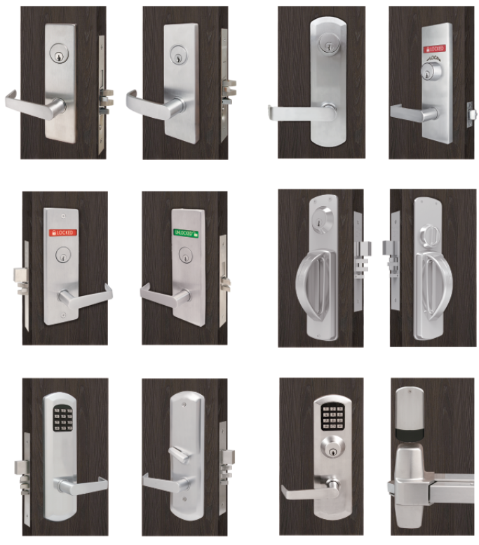
The Rejuvenator 2.0
TownSteel proudly presents Rejuvenator 2.0
  Fast and Easy Installation
  ANSI/BHMA Grade 1 Certified
  UL 10C 3 Hour Fire Rated
  Brand Equivalent Door preps
  Maintain Door Code Compliance
  Multi-functional trims or locks.
  Institutional Full Line Solution
  Mortise, Bored, and Exit Device Trims

Slide 4
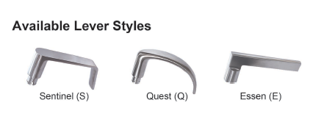
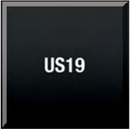
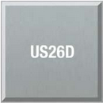
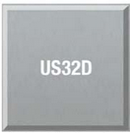
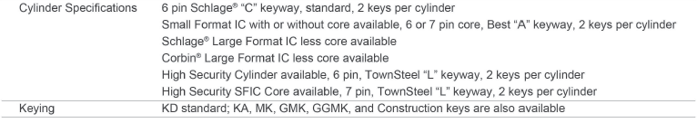
TownSteel Rejuvenator Standards

Slide 5
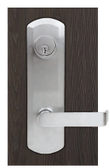
M-Kestros Exit Device Lever Trim
Compatible with TownSteel ED 1100, 9700, 8900
Compatible with VD 99 and 22 Series, Field Configurable
Non-Cylinder functions: Dummy and Passage functions are Field Selectable
Cylinder functions: Entrance and Night latch functions are Field Selectable
Designed to be ANSI Grade 1 heavy-duty
Non-handed, Field Reversible Handing
Notes:
Adjustable posts that we can use a coin, back end of key, flatblade screw driver to remove

Slide 6
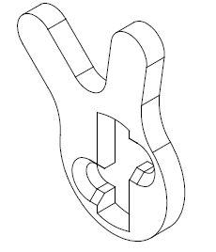
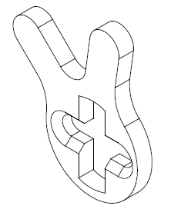
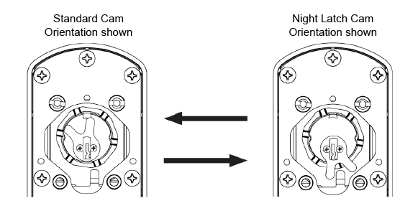
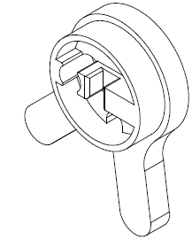
m-Kestros Exit Device Lever Trim

Slide 7
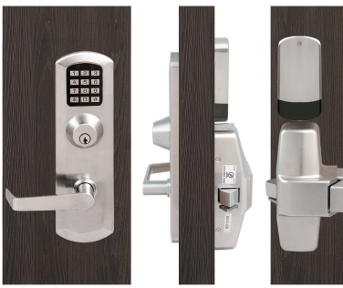
e-Kestros Electronic ED Lever Trim
Only electronic ED with or without key override
100 user codes
Available in Mortise or KIK cylinder variants
Emergency power input for non-keyed trims.
Weather resistant
Metal button keypad
Battery powered
4xAA batteries lab tested to 2-year battery life.
Compatible with all TownSteel ED
Compatible with VD 99 and 22 Series, Detex 10/40 Series, Cal Royal 2200, Sargent 80 Series, Falcon 19 Series, Dorma 9300 Series.
Notes:
We have available underplates for other top brands like Falcon, Yale, Corbin, Cal Royal

Slide 8
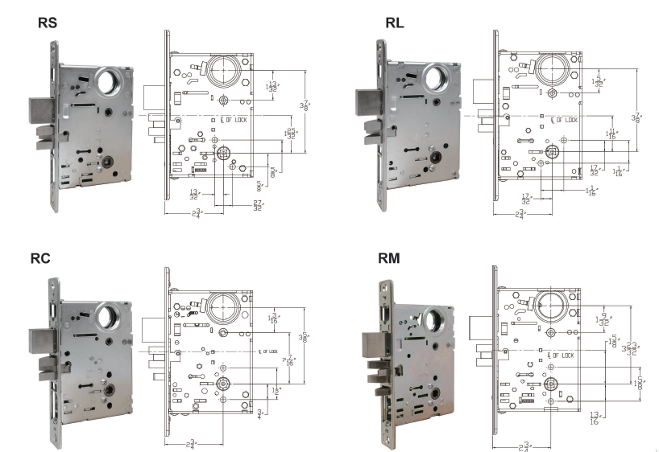
Rejuvenator Mortises
RS – Sargent 8200 series Prep
RL – Schlage L series Prep
RC – Corbin ML2000 Prep
RM – Marks 5 series Prep
RB – TownSteel MS series and Best 35/45 series
Notes:
Reinvented Our mortises to offer a brand equivalent solution to pre-existing door templates
Upgrade the operability, functionality, aesthetic, electronics
Maintain door codes

Slide 9
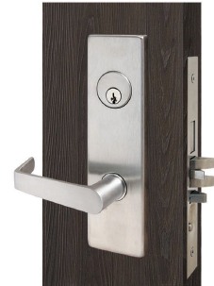
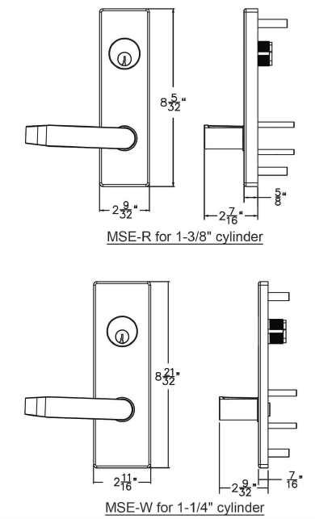
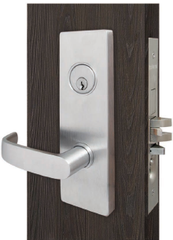
MSE-R and MSE-W Escutcheon Trim
Heavy Duty Stainless Steel
Wide or Regular Escutcheons
Sectional trim available
Fast and easy installation
Available Functions
  01,04,05,07,09,13,14,15,19,20,21,31,32,33,35
Notes:
Standard Escutcheon trim perfect for warehouse, storerooms, closets

Slide 10
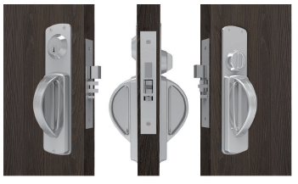
MRXA-R Ligature Resistant Trim
5-pt Ligature resistant
Extended Underplate
Cylinder Collar/Thumb turn constructed onto underplate
NYSOMH accepted
Paired with rejuvenator mortises make for fast and easy retrofit applications.
Notes:
MRXA-R on the front cover of the NYSOHM

Slide 11
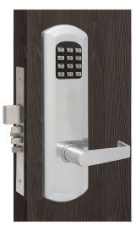
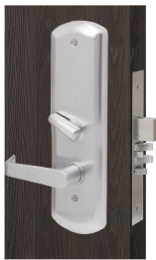
e-Kontos Electronic Mortise Trim
Programmable stand-alone mortise lock
100 user codes
Programmable Passage code
Illuminated 12-key mechanical keypad
Weather Resistant
Metal button keypad
With or without Key override
Emergency USB-C input for non keyed trim
4xAA batteries lab tested for 2 years battery life
Paired with Rejuvenator Mortises make for fast and easy retrofit applications.
Notes:
Higher tier electronics are available if that is what you require

Slide 12
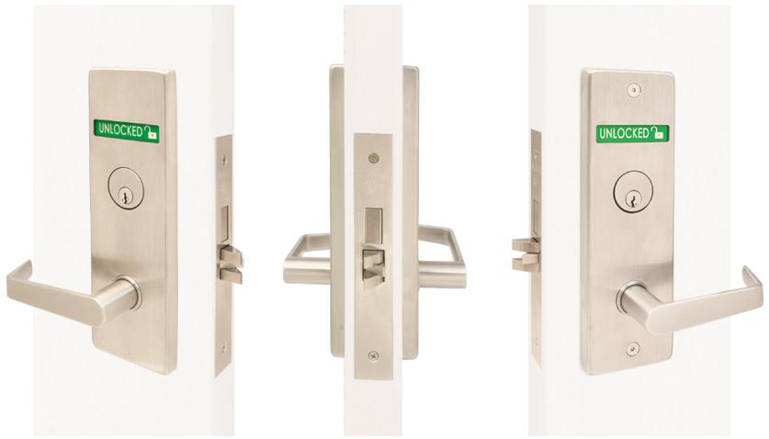
Aegis Mortise Large Message Indicator
Simplifies the upgrade process, saving time and money with Rejuvenator 2.0
Large message indicator allows quick recognition of lock status. Especially helpful for teachers, and LEO’s responding to a critical incident.
Always allows free egress, meeting Life Safety Code
Directional Engraving
Durable Message indicator on a metal plate
Accepts nearly all key cylinders
Available with cylinder x thumb turn, or cylinder x cylinder
Designed to meet ANSI/BHMA A156.13 Grade 1
Designed to meet UL 10(C) 3-hour fire rating
Notes:
Ordered handed, but can be field reversible
Directional engraving makes the lock handed so its optional

Slide 13
Rejuvenator Mortises
RS – Sargent 8200 series Prep
RL – Schlage L series Prep
RC – Corbin ML2000 Prep
RM – Marks 5 series Prep
RB – TownSteel MS series and Best 35/45 series
Notes:
Reinvented Our mortises to offer a brand equivalent solution to pre-existing door templates
Upgrade the operability, functionality, aesthetic, electronics
Maintain door codes

Slide 14
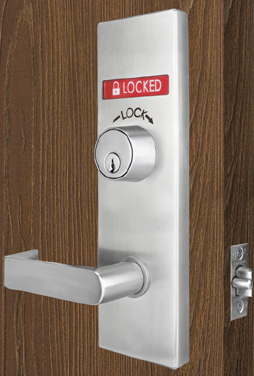
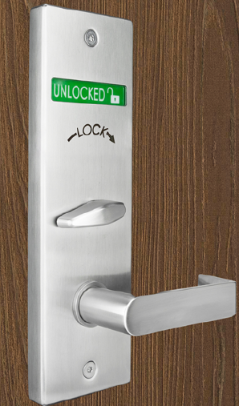
Aegis Bored Lock
  The ONLY double-sided large message indicator lock in the world that fits into a 161-door prep!
  Large message indicator allows quick recognition of lock status. Especially helpful for teachers, and LEO’s responding to a critical incident.
  Well suited for either new construction or retrofit projects, but it shines in a retrofit application
  Install won’t void door fire ratings.
  Always allows free egress, meeting Life Safety Code
  Accepts nearly all key cylinders
  Available with cylinder x thumb turn, or cylinder x cylinder (including mortise thumb turn)
  Directional Engraving
  Durable Message indicator on a metal plate
  Designed to meet ANSI/BHMA A156.2 Grade 1
  Designed to meet UL 10(C) 3-hour fire rating
  Patent Pending

Slide 15
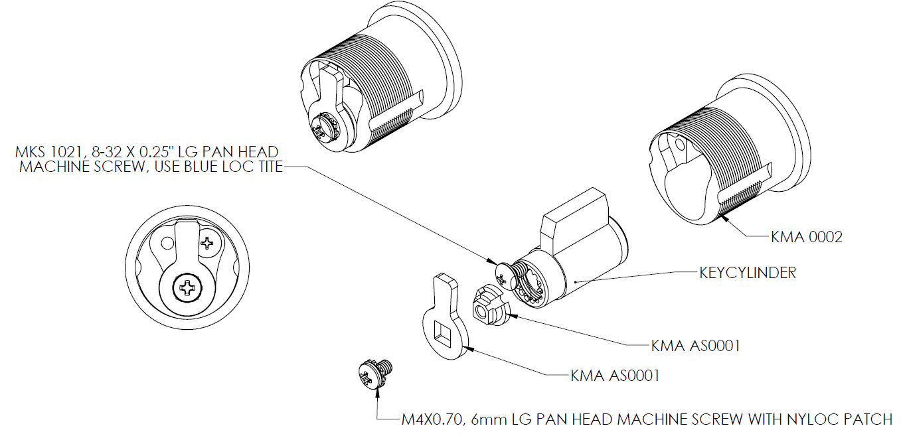
Aegis Bored Large Message Indicator

Slide 16
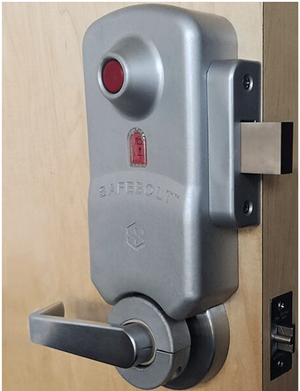
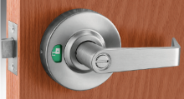
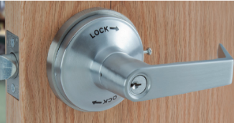
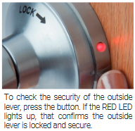
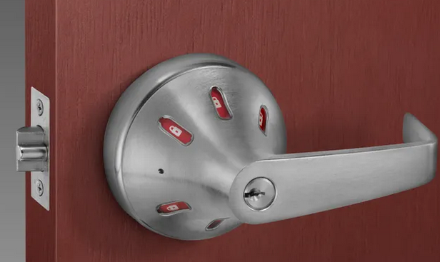
Competitor School Safety Bored Locks
Available only in Privacy
No classroom functions available
Operating Inside lever, retracts deadbolt and unlocks outside lever.

Slide 17
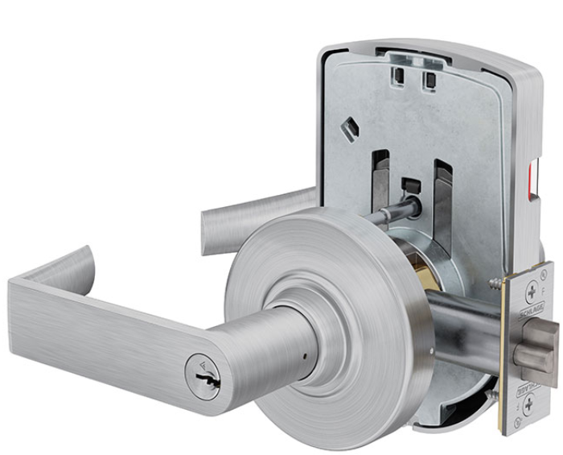
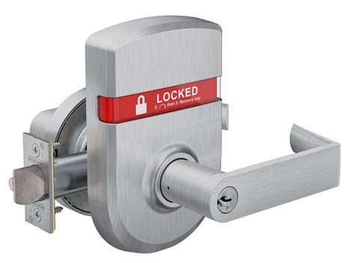
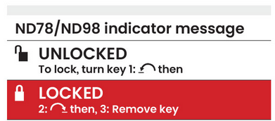
Competitor Bored School Safety Locks
Only available in 1 Classroom function F110
Only available with Inside Indicator
Small print with multiple instructions on how to lock outside lever.
Zinc, Zinc Dichromate with steel components

Slide 18
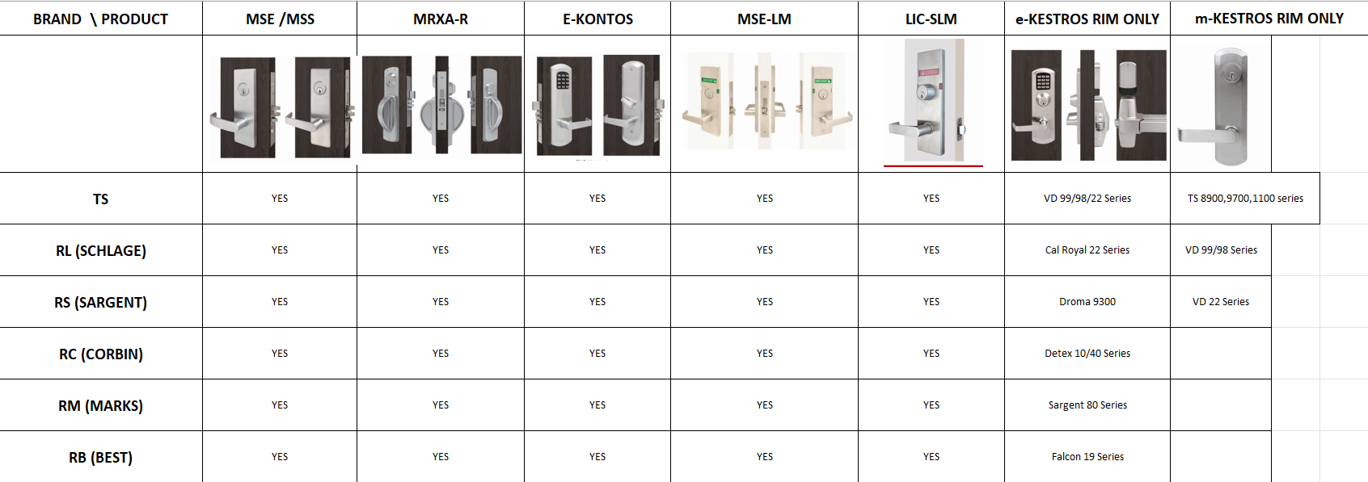
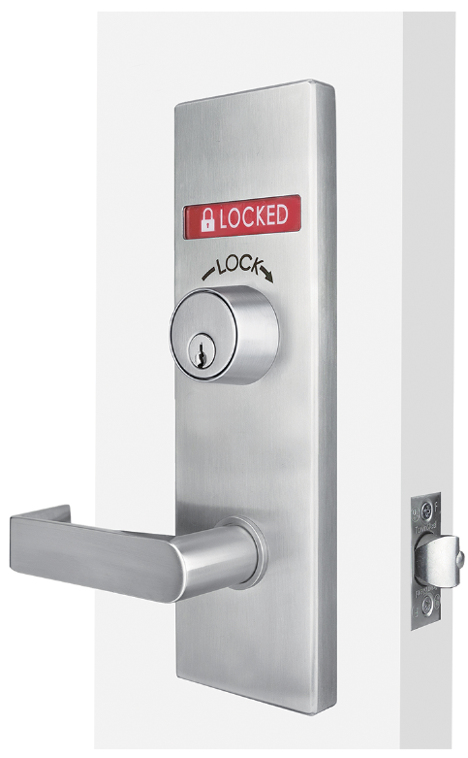
Rejuvenator Compatibility Matrix

